Slide 1
Preemption Threshold Scheduling
Zonghua Gu

Slide 2
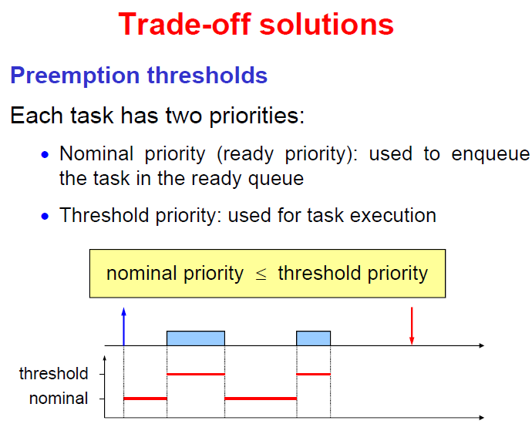
Tau₁ can preempt Tau₂ only if priority of Tau₁ is strictly greater than preemption threshold of Tau₂

Slide 4
PTS
PTS can be viewed as a tradeoff between fully preemptive and fully non-preemptive scheduling.
If each task’s PT is set equal to its nominal priority, it is equivalent to a fully preemptive scheduler
If all PTs are set to the maximum priority among all tasks, it is equivalent to a non-preemptive scheduler
By appropriately setting PTs, the system can improve the schedulability compared with fully preemptive and fully non-preemptive scheduling.

Slide 5
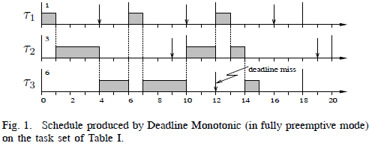
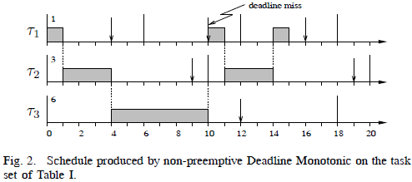
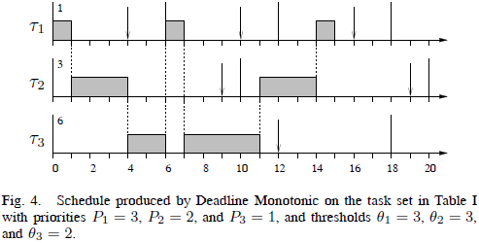
 | C_{i} | T_{i} | D_{i}
τ₁ | 1 | 6 | 4
τ₂ | 3 | 10 | 9
τ₃ | 6 | 18 | 12
τ₂ cannot preempt τ₃
here due to PT
 | C_{i} | T_{i} | D_{i} | Pri_{i} | PT_{i}
τ₁ | 1 | 6 | 4 | 3 | 3
τ₂ | 3 | 10 | 9 | 2 | 3
τ₃ | 6 | 18 | 12 | 1 | 2
Notes:
at t = 6, 1 can preempt 3 since P1 > Theta3.
However, at t = 10, 2 cannot preempt 3, being P2 = Theta3.
Similarly, at t = 12, 1 cannot preempt 2, being P1 = Theta2.

Slide 6
Feasibility Analysis
TODO
Notes:
1The original analysis by Wang and Saksena [15] has been corrected by
Regehr [25], which in its turn has been improved by Keskin et al. [24].

Slide 7
Setting PTs
Notes:
Saksena & Wang 01

Slide 8
Gai PhD 04
Notes:
Based on this idea, Wang and Saksena, [58, 63] developed the concept of Preemption
Threshold: each task i is assigned a nominal priority i and a preemption threshold i
with i i. When the task is activated, it is inserted in the ready queue using the nominal
priority; when the task begins execution, its priority is raised to its preemption threshold;
in this way, all the tasks with priority less than or equal to the preemption threshold of
the executing task cannot make preemption. According to [58], I introduce the following
denitions:
Denition 1 Two tasks i and j are mutually non-preemptive if (i j ) ^ (j i).
Denition 2 A set of tasks G = f1; 2; : : : ; mg is a non-preemptive group if, for every
pair of tasks j 2 G and k 2 G, j and k are mutually non.preemptive.

